Slide 1
Micro-Project 4
Adult Income Deep Learning Classification
DATASET
Adult Income
DELIVERABLE
Classification modeling
Dense Neural Network and Feature-Sequence LSTM
Repository link: add after GitHub upload
AUTHOR
Valentin Diaconu
Valentin Diaconu
October 11, 2026
ADULT INCOME CLASSIFICATION
01
Notes:
Add the GitHub repository link after uploading the executed notebook.

Slide 2
SCOPE
02
Methodological Disclosure
Adult Income has no time variable
The dataset is cross-sectional. Each row describes a different adult, so the project performs deep learning classification rather than genuine time-series forecasting.
For the LSTM demonstration, the 89 encoded predictors form an analyst-defined feature sequence. Sequence positions represent encoded variables, not time. The LSTM result demonstrates recurrent architecture only and does not provide evidence of temporal learning.
This limitation affects whether the project fully satisfies a time-series requirement.
ANA500 Micro-Project 4 Valentin Diaconu
2
Notes:
This disclosure prevents the LSTM feature order from being represented as a real time series.

Slide 3
QUESTION
03
Problem Statement and Hypothesis
Problem statement
Hypothesis
Can deep neural networks use demographic, educational, and employment characteristics to classify whether an adult reports income above $50,000?
The MLP and LSTM will outperform the majority baseline because nonlinear layers can represent predictor interactions. The LSTM may not outperform the MLP because the encoded predictors have no natural temporal order.
Target: income >$50K Task: binary classification
ANA500 Micro-Project 4 Valentin Diaconu
3
Notes:
Wording assisted by OpenAI ChatGPT and reviewed by the author (OpenAI, 2026).

Slide 4
STEPS 1-2
04
Acquire and Prepare
Adult Income dataset
Preparation and split
• 32,561 acquired records and 15 original fields
• Unknown categories retained instead of deleting incomplete rows
• 24 exact duplicates removed
• 32,537 prepared records
• Numerical fields standardized; categorical fields one-hot encoded
• 24.09% report income above $50K
• Stratified 70% training, 15% validation, and 15% test split
• Preprocessing fitted only on training data
22,775 training 4,881 validation 4,881 test
ANA500 Micro-Project 4 Valentin Diaconu
4
Notes:
The prepared design follows the earlier Adult Income micro-project decisions.

Slide 5
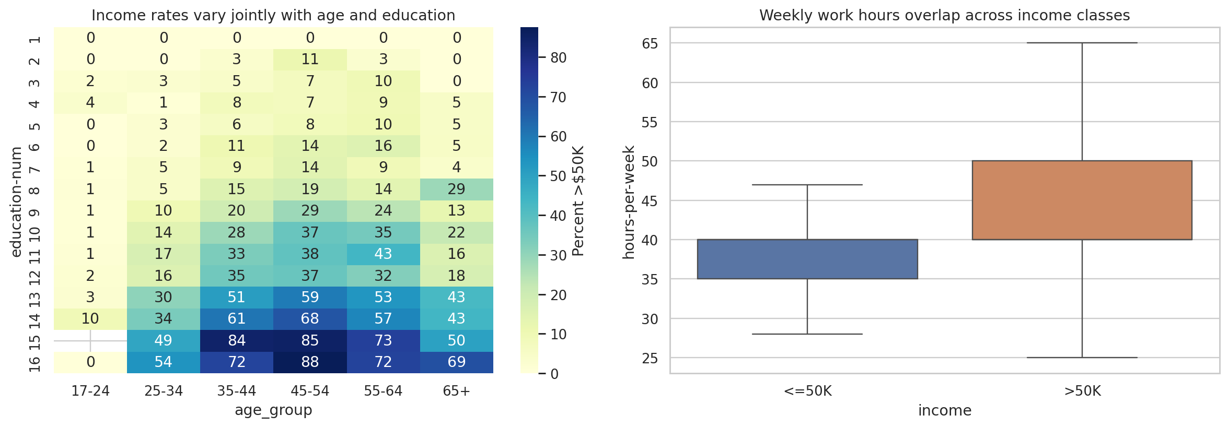
PREPARE
05
Exploratory Interactions
Income rates vary jointly with age and education, while weekly-hours distributions overlap across classes.
ANA500 Micro-Project 4 Valentin Diaconu
5
Notes:
Charts describe associations in the prepared historical sample and do not establish causal effects.

Slide 6
STEP 3
06
Deep Learning Classification Design
1
2
3
4
Baseline
Linear benchmark
Dense network
Recurrent network
Majority class
Logistic regression
MLP
LSTM
Predicts <=$50K for every test record
Tests an additive decision boundary
Uses two nonlinear hidden layers
Processes encoded features as an artificial sequence
Neural models: class weights, Adam optimization, binary cross-entropy, dropout, L2 regularization, and early stopping
LSTM feature order is non-temporal and analyst-defined.
ANA500 Micro-Project 4 Valentin Diaconu
6
Notes:
MLP trained for 14 epochs. LSTM reached the 40-epoch limit and required substantially more computation.

Slide 7
STEP 4
07
Test-Set Model Performance
Interpretation
• Dense MLP achieved the highest ROC-AUC at 91.79%.
• MLP F1 reached 70.46% with recall of 87.84%.
• The feature-sequence LSTM reached 81.80% ROC-AUC.
• Its weaker result reflects the absence of temporal structure.
ANA500 Micro-Project 4 Valentin Diaconu
7
Notes:
The majority baseline achieved 75.91% accuracy but zero recall for the >$50K class.

Slide 8
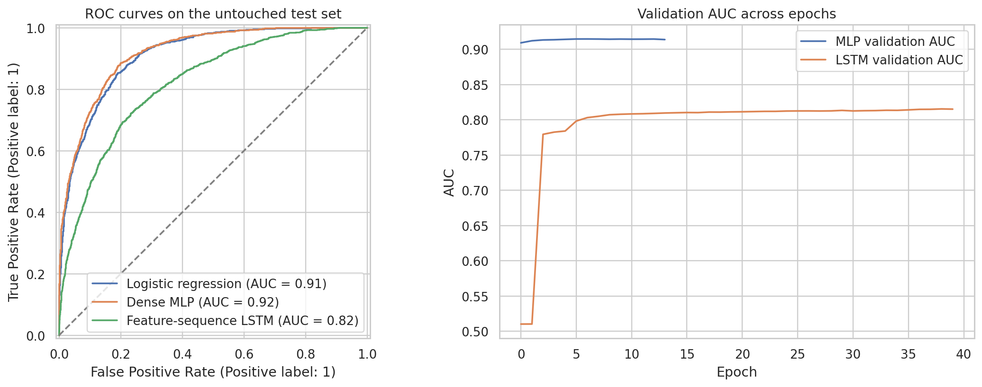
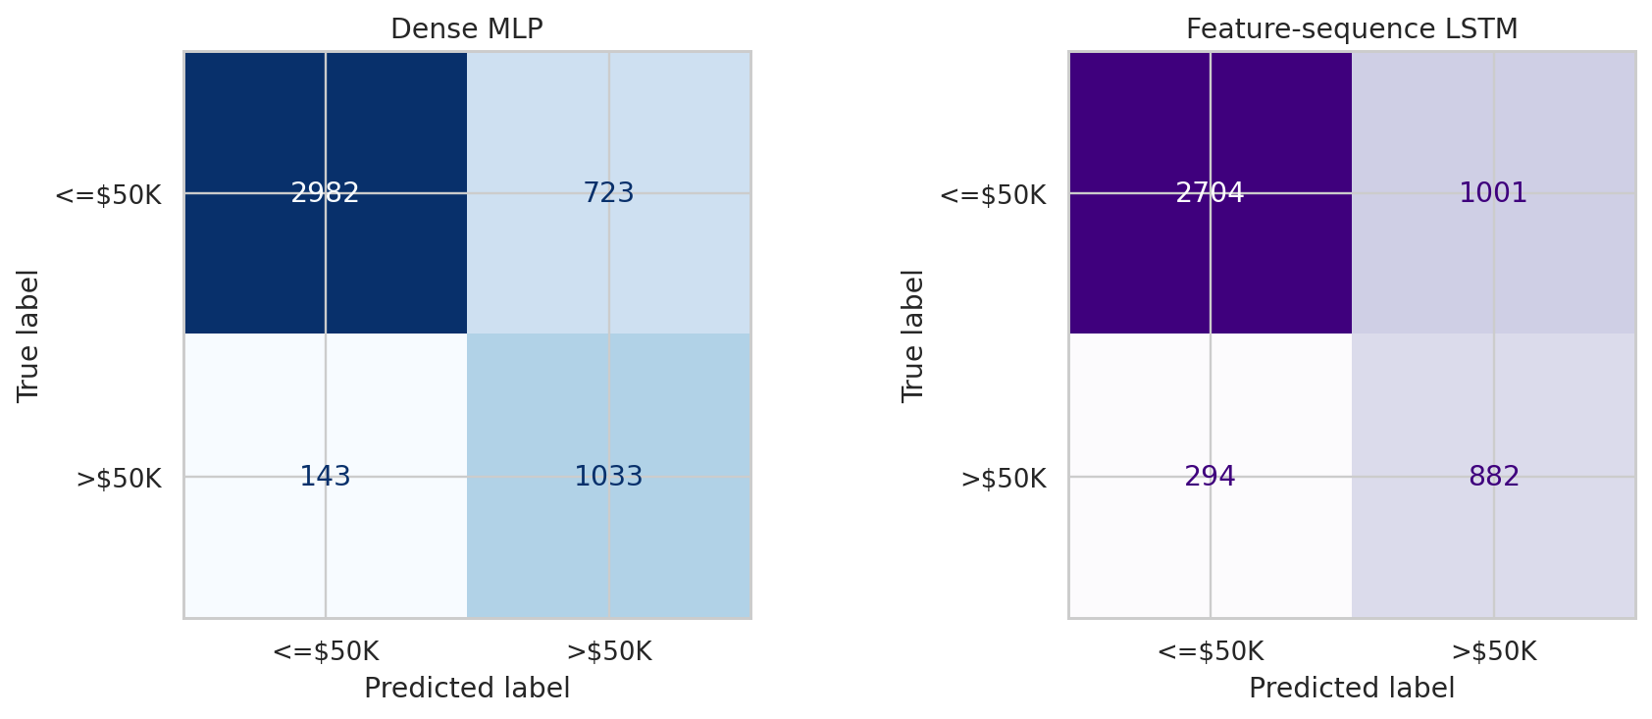
REPORT
08
ROC, Learning, and Classification Errors
The MLP separated the classes more effectively. Both neural models still produced false positives and false negatives.
ANA500 Micro-Project 4 Valentin Diaconu
8
Notes:
All diagnostics use the untouched 4,881-record test set or the separate validation partition.

Slide 9
STEP 5
09
Conclusion and Action
Selected benchmark
Responsible next steps
Dense MLP
• Tune the probability threshold for a defined analytical purpose.
• Accuracy: 82.26%
• Check calibration and subgroup performance.
• ROC-AUC: 91.79%
• Recall: 87.84%
• Use current representative data before external application.
• F1 score: 70.46%
• Keep human review for any consequential decision.
Conclusion: the MLP supported the nonlinear hypothesis; the LSTM did not add value without a real sequence.
ANA500 Micro-Project 4 Valentin Diaconu
9
Notes:
The project should not support employment, credit, compensation, or eligibility decisions.

Slide 10
COMPLIANCE
10
AI Use Disclosure and References
AI use disclosure
References
• OpenAI ChatGPT assisted with planning, code drafting, debugging, and phrasing.
Becker, B., & Kohavi, R. (1996). Adult [Dataset]. UCI Machine Learning Repository.
National University. (2026). ANA500 Module 4: Neural Network Modeling with Python.
OpenAI. (2026). ChatGPT [Large language model].
TensorFlow Developers. (2026). TensorFlow and Keras documentation.
• The author reviewed and executed the code and remains responsible for accuracy.
• All values and charts come from the executed Adult Income analysis.
• The methodological limitation of the LSTM is disclosed throughout.
Repository link: add after GitHub upload
ANA500 Micro-Project 4 Valentin Diaconu
10
Notes:
The complete disclosure and references appear in the accompanying notebook.

